Slide 1
Virginia Peninsula Community College
The Peninsula’s Community College
Dual Enrollment Orientation

Slide 2
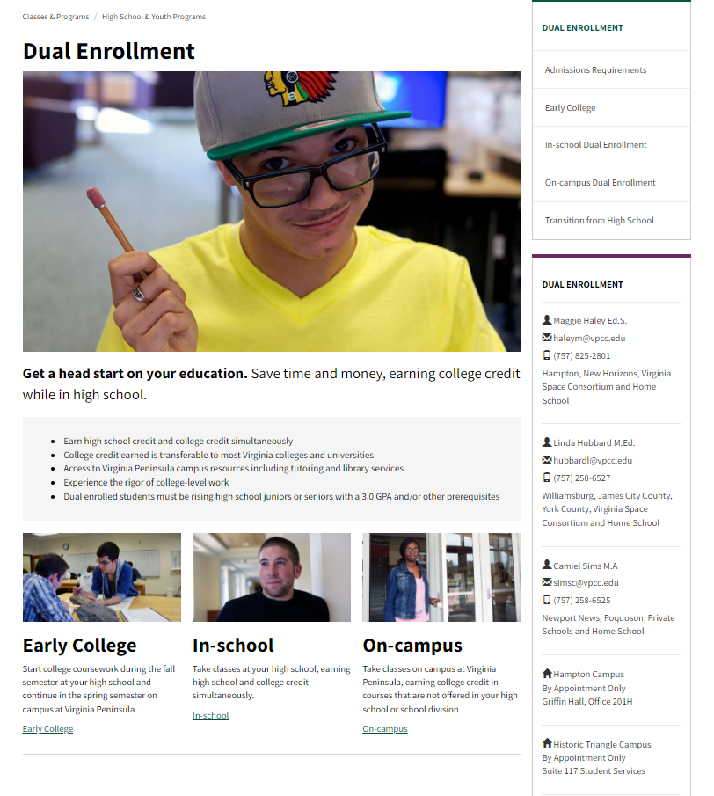
vpcc.edu

Slide 3
What is Dual Enrollment?
Dual Enrollment is a program that provides qualified high school students like you the opportunity to enhance their education by enrolling early in college courses. You will be able to experience college-level courses, explore career options, and shorten the time required to complete a college degree. In most cases, you have the opportunity to earn high school and college credit at the same time.

Slide 4
Benefits of Dual Enrollment
Get a head start on achieving your college degree
Access a wide range of college course options
Explore potential areas of study before declaring a major
Challenge yourself academically
Satisfy high school and college requirements at the same time
Lower the total cost of your college degree
Experience the rigor of college coursework while still in high school
Access all of Virginia Peninsula’s student services and resources

Slide 5
Things to Consider
College courses are more difficult and demanding than high school classes
Grades become a permanent part of your high school and college record
If you plan to attend a four-year college or university, make sure to check with them about how dual enrollment classes are accepted and applied in your anticipated degree
Withdrawing from a class can impact your future financial aid
College classes may include content that is controversial or makes you feel uncomfortable

Slide 6
Other Differences
between high school and college courses
Schedules – semesters and sessions
Terminology – credit hours, pre-reqs, office hours, mid-terms
Attendance - instructor sets policy
Grading - papers, exams
Expectations – no reminders, no hand-holding
Responsibility – know the material, the syllabus, due dates
Study time – 2-3 hours per credit, per week
Homework – expected, not graded

Slide 7
Attendance
Courses taught in the high school: The policies and procedures of the school division may apply. Students will adhere to the policy listed on the course syllabus.
Courses taught at Virginia Peninsula: Professors establish their own attendance policies for students to follow. Students may be dropped for non-attendance.

Slide 8
Student Resources
Dual enrollment students have access to the full range of student services and resources available at Virginia Peninsula Community College. These include:
Online resources through MyVPCC like Navigate, Gmail, Canvas, and SIS
Access to dual enrollment coordinators to help you plan for the future and navigate your college experience
Library resources, including tutoring both in-person and online
Disability accommodations arranged through our Office of Accessibility oas@vpcc.edu
Technology support via the Technology Help Desk
Student ID and parking permit

Slide 9
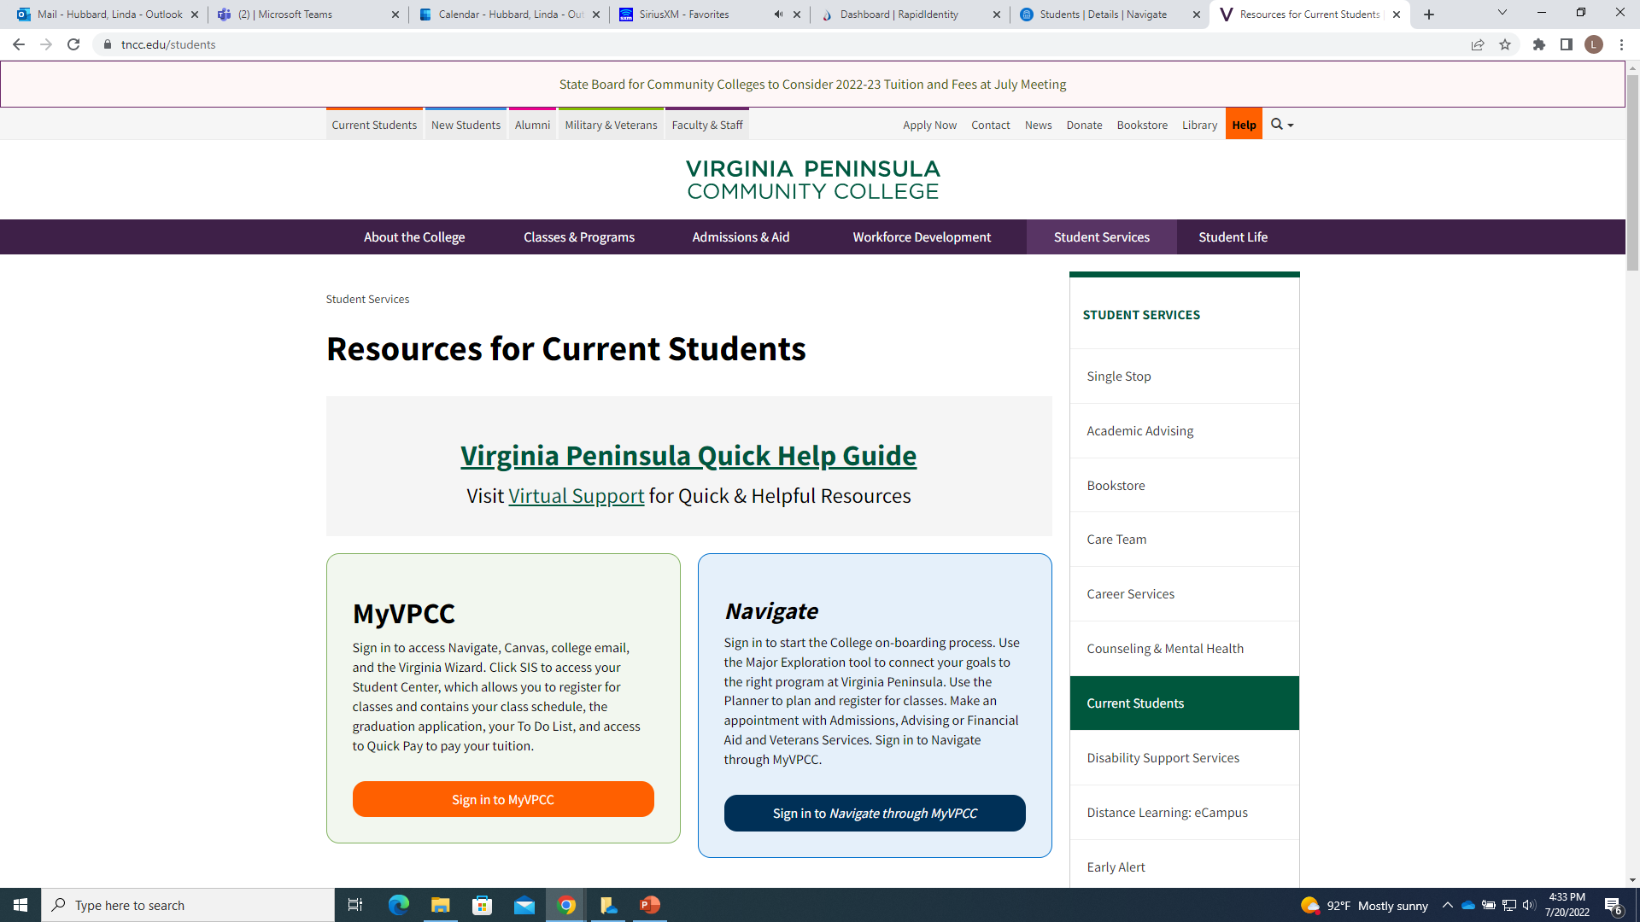
MyVPCC
MyVPCC is your online hub for important information.
Click

Slide 10
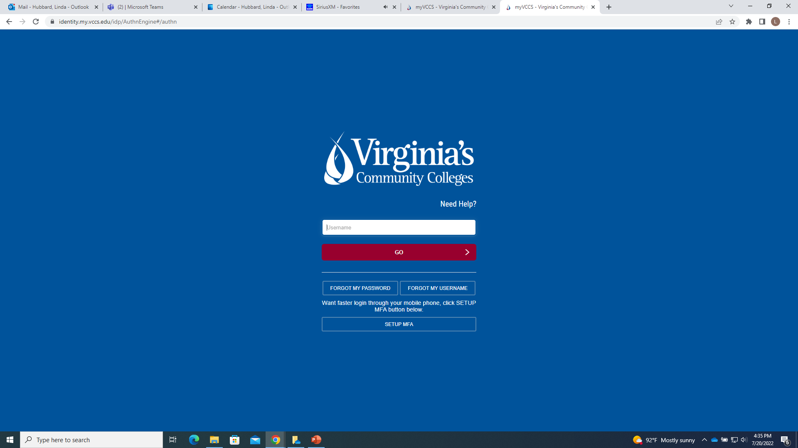
MyVPCC
Enter your username & password
Call the Technology Help Desk [825-2709] for help logging in to your account.

Slide 11
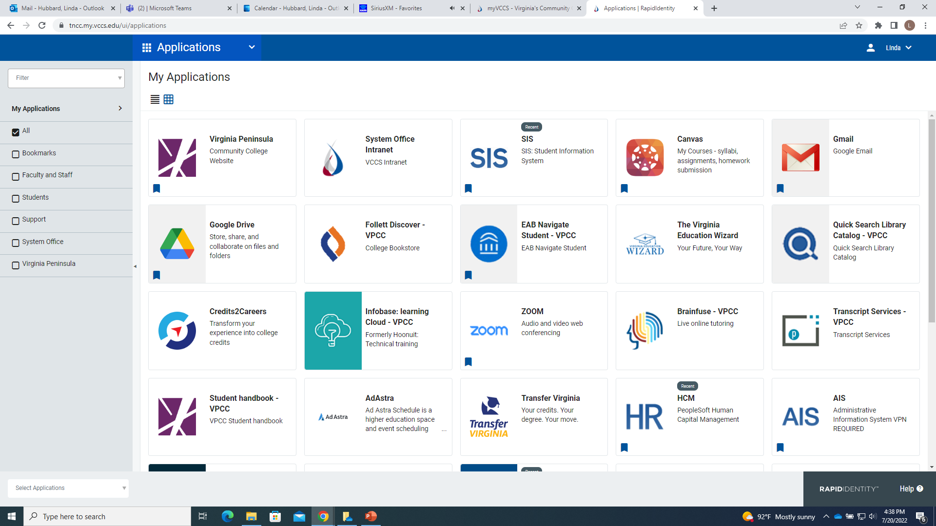
MyVPCC
Check out the circled apps for access to important information and resources

Slide 12
Academic Calendar
The Academic Calendar lists all of the important dates you need to know including:
First and last day of classes
Last date to drop classes for a refund
Last date to withdraw from a class for a grade of “W”
And many more important dates and deadlines
The calendar you follow varies based on where you are taking classes.
In-School
Academic Calendar
(classes in your high school)
On-Campus
Academic Calendar
(classes at Virginia Peninsula)

Slide 13
Grades
The grades of A, B, C and D are passing grades, but only A, B and C transfer to other institutions. The grade of F is a failing grade.
The quality of performance in any academic course is reported by a letter grade, the assignment of which is the responsibility of the instructor.
A Excellent: 4 grade points per credit
B Good: 3 grade points per credit
C Average: 2 grade points per credit
D Poor: 1 grade point per credit
F Failure: 0 grade points per credit
**Note that Virginia Peninsula does not assign + or – grades
Remember, the grades you earn at college are permanent, and will be seen by employers, University admissions staff, etc.

Slide 14
Withdrawal
You are strongly encouraged to withdraw from a course if it is likely that you will earn a D or F
A grade of D will not transfer to another college
A grade of D or F will become a permanent part of your record and negatively impact your GPA
A grade of W will become a permanent part of your record but will not negatively impact your GPA
Withdrawal deadline are established each semester and vary with the location of the class. You MUST withdraw on or before the established deadline to receive a “W” grade instead of a “D” or “F”
ALWAYS speak to the instructor and counselor before you make a decision
If you choose to withdraw, contact a dual enrollment coordinator or your high school counselor to discuss the withdrawal process

Slide 15
Student Services
All dual enrollment students have access to the same services as other Virginia Peninsula students. Please take advantage of them to support your success at Virginia Peninsula Community College and beyond!
Office of Accessibility
Tutoring
oas@vpcc.edu
Library
Technology
Help Desk

Slide 16
Student ID card & Parking Permit
Bring with you:
State or government issued identification
Student ID # (EMPLID)
Complete Parking Permit application form online
Bring to ID/Parking office to pick up permit
Hampton campus: Library Historic Triangle campus: room 115

Slide 17
As a Virginia Peninsula student, you are expected to be familiar with the Student Handbook and abide by its policies
Virginia Peninsula Community College Student Handbook
https://www.vpcc.edu/about/policy Code of conduct
Dress Code
Scholastic Dishonesty
Two attempt policy
Grade Appeal
Drug and Alcohol policy
Medical emergencies
Weapons policy
Omni Alert system
Gender neutral bathrooms
Parking
Inclement weather
Much, much more
Student Handbook

Slide 18
Family Educational Rights and Privacy Act (FERPA)
When a student turns 18 years old or enters a postsecondary institution at any age, all rights afforded to parents under FERPA transfer to the student. We will not share your information with anyone without your consent – except where allowed by law.
For a list of exceptions and our full FERPA policy, review the FERPA section of the student handbook.

Slide 19
Scholastic Dishonesty
Scholastic dishonesty will not be condoned under any circumstances. It may include:
Cheating on a test or quiz
Giving or receiving information; copying others’ work
Using unauthorized materials during a test
Collaborating during a test
Substituting for someone else during a test
Plagiarizing (submitting another’s work as your own)
Working with others to complete an assignment unless collaboration was authorized by the instructor
More information about scholastic dishonesty can be found in the handbook.

Slide 20
Report an Incident
Use the Report an Incident link at the bottom of the VPCC homepage to report :
Academic dishonesty
Code of conduct violations
Disruptive classroom behavior
Mental or physical health concerns
Threats
General concerns
Discrimination / Sexual misconduct
Other behavioral concerns

Slide 21
Thanks for completing DE Orientation!
Congratulations! You now know all the basics of life as a college student at Virginia Peninsula Community College.
If you need anything or have any further questions, your Dual Enrollment Coordinators are only a phone call or email away. We’re excited to watch you succeed here at
Virginia Peninsula
the Peninsula’s Community College!

Slide 22
Dual Enrollment Coordinators
Available to help with all your dual enrollment needs
Maggie Haley HCS, NHREC
Hampton Campus haleym@vpcc.edu
Linda Hubbard YCSD, WJCC, GSST
Historic Triangle Campus hubbardl@vpcc.edu
Camiel Sims NNPS, PCS, Private schools
Historic Triangle Campus simsc@vpcc.edu
By appointment: phone, zoom, in person

Slide 23
Virginia Peninsula Community College Dual Enrollment Orientation Quiz
Dual enrollment gives a student the opportunity to earn high school and college credit at the same time? True or False
2. Grades earned through dual enrollment are a permanent part of your high school and college record?
True or False
3. _______________ is the online platform for Virginia Peninsula Community College.
Blackboard
Canvas
Foxpro
4. All communications from the college will be sent to your VPCC Gmail account. True or False
5. A student should check his or her VPCC student Gmail account at least once every:
Week
Semester
Day
6. In SIS a student can view his/her schedule, grades, and pay for classes. True or False

Slide 24
7. ______________ can help a student keep track of important tasks, explore major and career interests, create and academic plan and make an appointment with an advisor.
Oracle
SIS
Navigate
8. All dual enrolled students have access to the same services as other Virginia Peninsula students. True or False
9. Student Services at VPCC include:
Library Resources
Tutoring
Disability Support Services
All of the above
10. VPCC professors establish their own Attendance Policies. True or False
11. FERPA regulations require VPCC to share your academic information with your parents True or False
12. The VPCC Student Handbook explains what constitutes Scholastic Dishonesty. True or False

